Slide 1
Capstone Design Project2_Seokju Koh
High Availability System
in Cloud Environment
using WAS Clustering
TEAM 5
2012105055 JongYoung Son
2016115113 SunHee Kim
2016117078 HyunKyung Cho
2016114418 KeunRyeong Bae

Slide 2
Contents
Team members
Background
About Project
Activities
Future plan

Slide 3
Ⅰ. Team Members

Slide 4

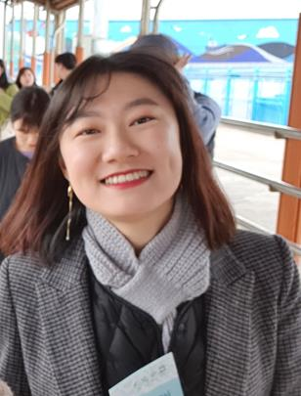

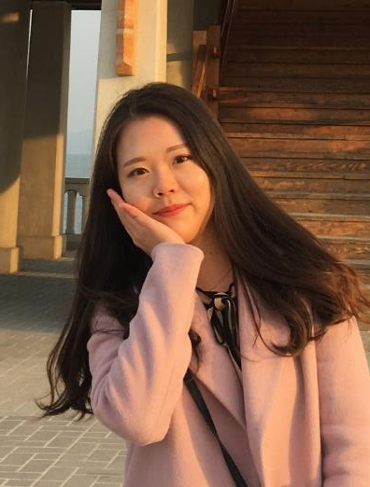
Ⅰ. Team Members
Construct WEB/WAS server
System Integration
Construct testing environment
System testing
Construct WEB/WAS server
Manage Trello
Construct testing environment
Manage Git
JongYoung Son
KeunRyeong Bae
HyunKyung Cho
SunHee Kim

Slide 5
Ⅱ. Background

Slide 6
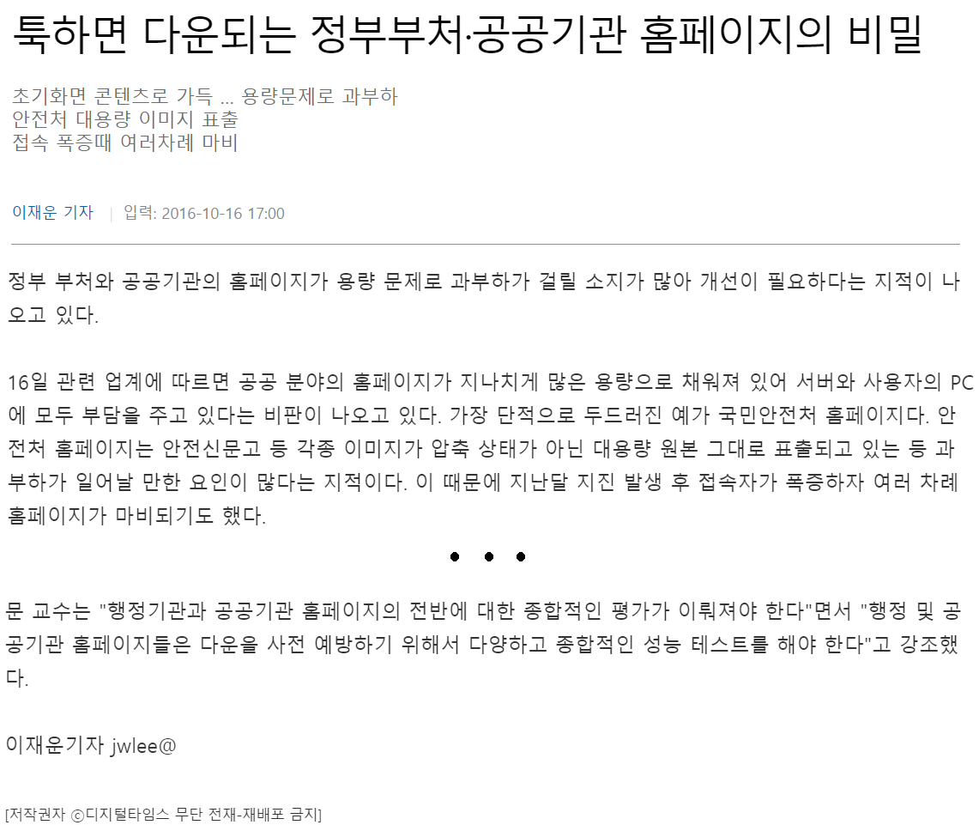
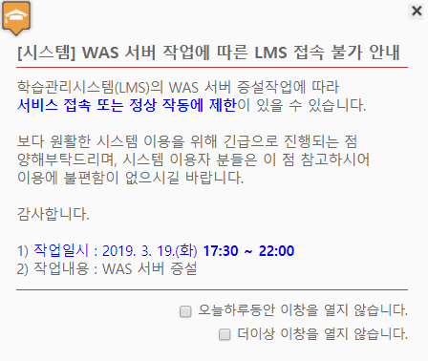
Ⅱ. Background
『High Availability System』
Notes:
우리는 실제로 퍼블릭 클라우드 환경에서 구성된 웹 서비스에 web, was 구성을 이중화하고 2개의 was를 session clustering하여
하나의 어플리케이션에 문제가 생기더라도 전체 서비스에 영향을 주지 않는 고가용성 시스템을 구축하여 공공기관이나 기업체등에서 사용할 수 있는 안전한 오픈소스 웹 시스템을 구축하려한다.

Slide 7
Ⅲ. Project Progress

Slide 8





Ⅲ. Project Progress
『WAS1』
Web Browser
『WEB』
『WAS2』

Slide 9




Ⅲ. Project Progress
Cloud
Session clustering
Load balancing
Sticky session
WAS1
Web Browser
WEB
WAS2

Slide 10
Ⅲ. Project Progress
Demo Video
https://www.youtube.com/watch?v=l0X8CPkdBtU

Slide 11
Ⅳ. Activities

Slide 12
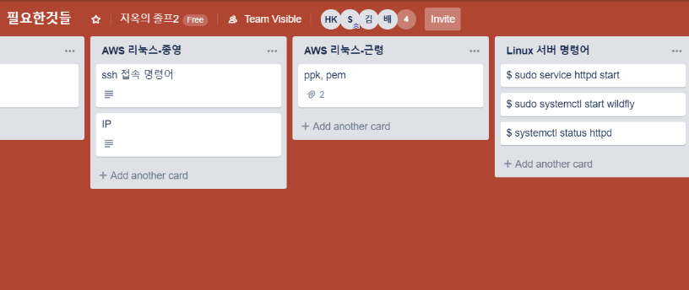
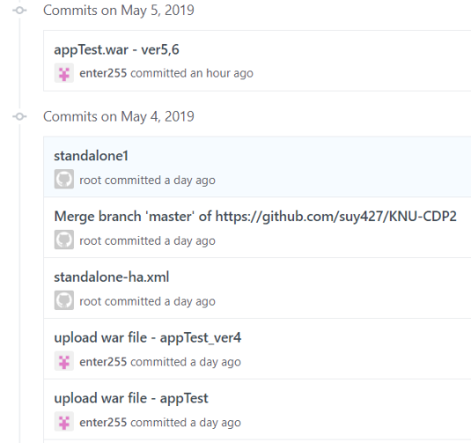
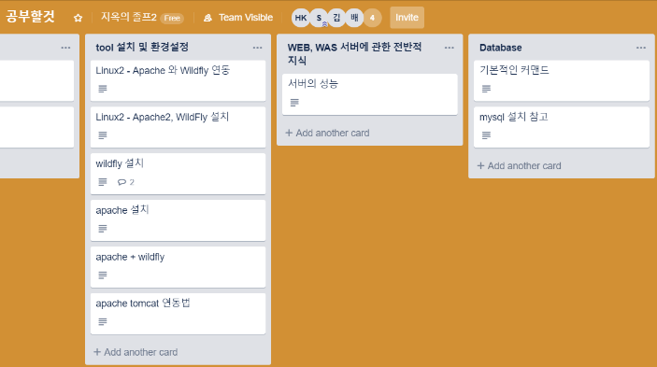
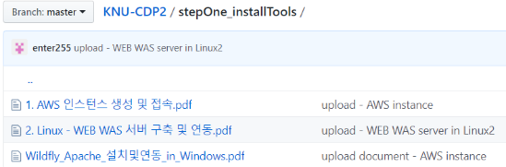
Ⅳ. Activities
Trello
Github
Materials and Schedule Management
Project Documents and Sources Management

Slide 13
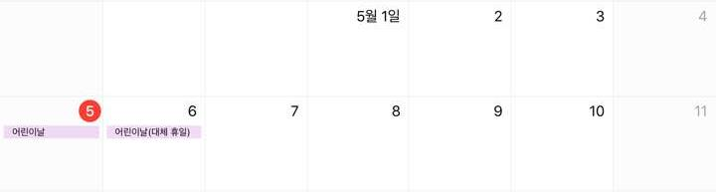

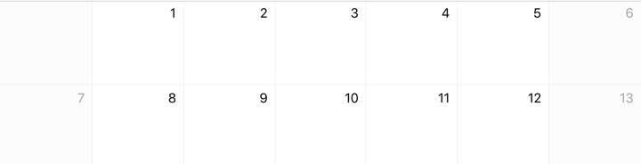
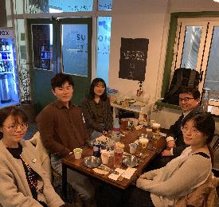
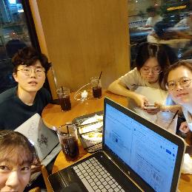
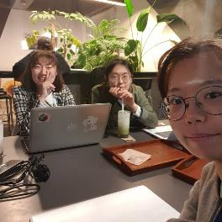
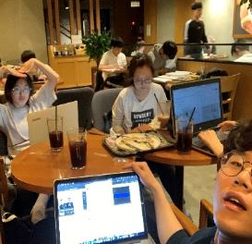
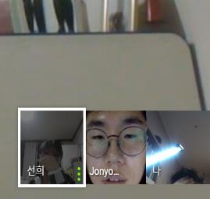
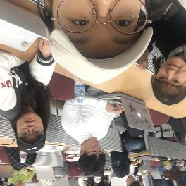
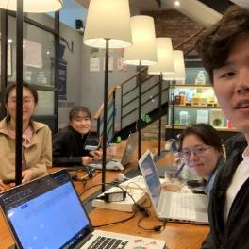

Ⅳ. Activities
Offline & Online
Today

Slide 14
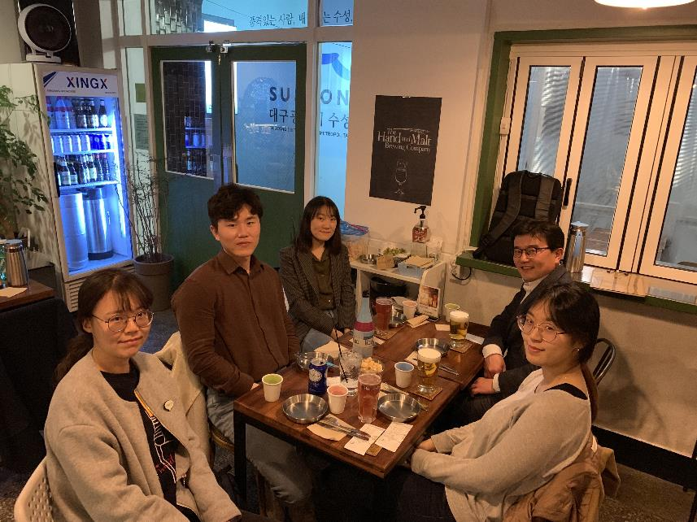
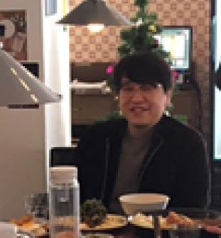
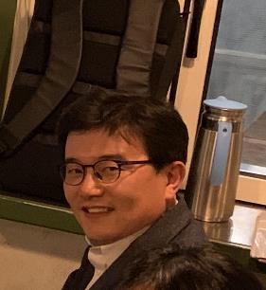

Ⅳ. Activities
Offline meeting
Notes:
4월 1일!

Slide 15
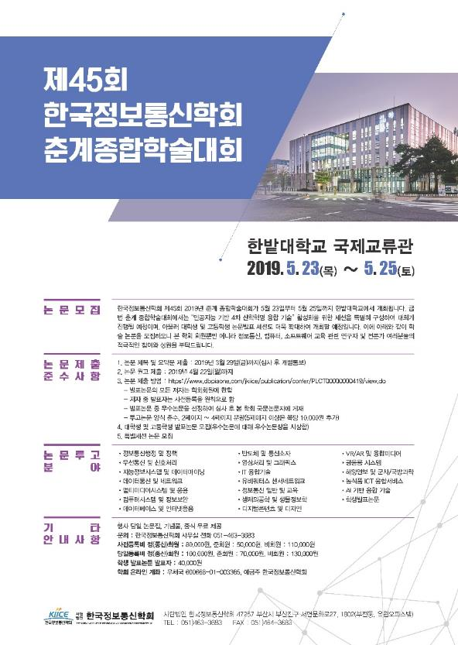
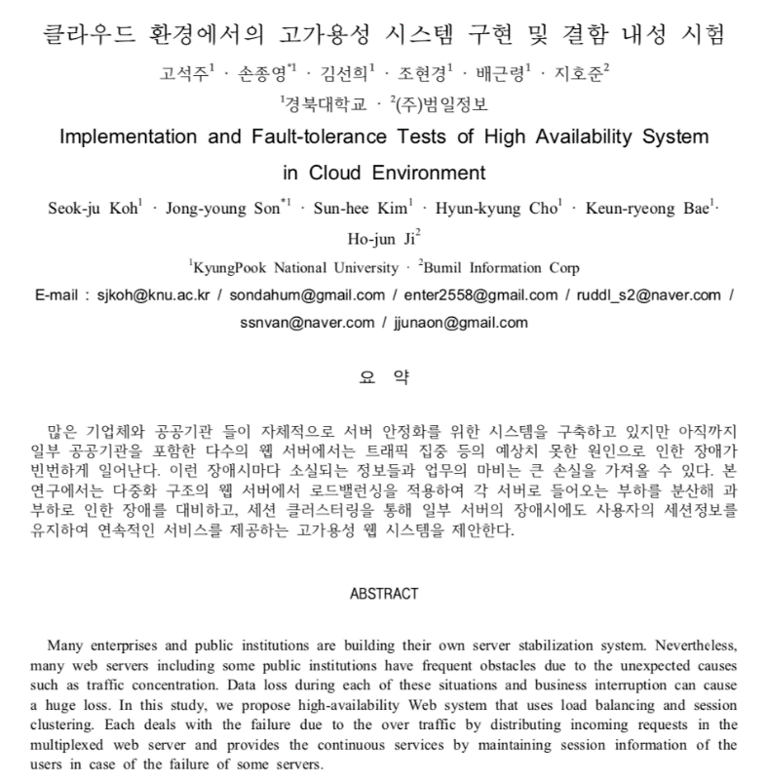
Ⅳ. Activities
Participate in Symposium : 5/24

Slide 16
Ⅴ. Future Plan

Slide 17
Ⅴ. Future Plan
 | Mar. |  |  |  | Apr. |  |  |  | May.
 | 2nd week | 3rd week | 4th week | 5th week | 1st week | 2nd week | 3rd week | 4th week | 1st week | 2nd week | 3rd week | 4th week | 5th week
Planning
Study about topic
Construct cloud environment
Construct WEB/WAS server
Clustering WAS server
Testing
Completion
Paper

Slide 18
Q n A
Thank you

